Slide 1


HI6039 (Predictive Analysis)
Dr. Farshid Keivanian
Week 4: Addressing Overfitting in Predictive Analytics

Slide 2
Group Assignment Note
Students are expected to use a Python-based analytics environment. Google Colab is recommended. Jupyter Notebook or VS Code may also be used. Other analytics tools such as KNIME may be used only with lecturer approval.

Slide 3
Individual Assignment Note
No coding or model implementation is required for this assessment. Students are expected to critically evaluate predictive analytics tools and environments in discussion only.

Slide 4
Referencing Style
The referencing style should remain:
Holmes Adapted Harvard
This should be used consistently throughout the assessment documentation.

Slide 5
What students already know (from Week 2 and 3)
Regression (predict number)
Classification (predict category)
Basic pipeline (train → predict → evaluate)
Fitting a Predictive Model to Data

Slide 6
Week 4 Learning Focus
Students will learn:
What overfitting means
How to detect overfitting
How to reduce overfitting
How model performance changes with tuning

Slide 7
Week 4 Learning Focus
In simple terms: This week is about how to stop models from being “too smart” on training data but bad on new data.

Slide 8
Example 1 – Detect Overfitting (Classification)
from sklearn.datasets import load_iris
from sklearn.tree import DecisionTreeClassifier
from sklearn.model_selection import train_test_split
from sklearn.metrics import accuracy_score
# load dataset
data = load_iris()
X = data.data # features
y = data.target # labels
# split data
X_train, X_test, y_train, y_test = train_test_split(X, y, test_size=0.3, random_state=42)
https://colab.research.google.com/drive/1SfEjObUXoxT60OyzMOlojqvmlI6yQ_2m?usp=sharing

Slide 9
Example 1 – Detect Overfitting (Classification)
from sklearn.datasets import load_iris
from sklearn.tree import DecisionTreeClassifier
from sklearn.model_selection import train_test_split
from sklearn.metrics import accuracy_score
# load dataset
data = load_iris()
X = data.data # features
y = data.target # labels
# split data
X_train, X_test, y_train, y_test = train_test_split(X, y, test_size=0.3, random_state=42)
1. Import Tools: We’re importing ready-made tools:
dataset → to get sample data
model → to learn patterns
train/test split → to divide data
accuracy → to check how good the model is
https://colab.research.google.com/drive/1SfEjObUXoxT60OyzMOlojqvmlI6yQ_2m?usp=sharing

Slide 10
Example 1 – Detect Overfitting (Classification)
from sklearn.datasets import load_iris
from sklearn.tree import DecisionTreeClassifier
from sklearn.model_selection import train_test_split
from sklearn.metrics import accuracy_score
# load dataset
data = load_iris()
X = data.data # features
y = data.target # labels
# split data
X_train, X_test, y_train, y_test = train_test_split(X, y, test_size=0.3, random_state=42)
2. Load the dataset:
This loads a flower dataset (Iris dataset)
X = features (measurements like petal length, width, etc.)
y = labels (type of flower)
Think:
X = information about the flower
y = the correct answer (flower type)
https://colab.research.google.com/drive/1SfEjObUXoxT60OyzMOlojqvmlI6yQ_2m?usp=sharing

Slide 11
Example 1 – Detect Overfitting (Classification)
from sklearn.datasets import load_iris
from sklearn.tree import DecisionTreeClassifier
from sklearn.model_selection import train_test_split
from sklearn.metrics import accuracy_score
# load dataset
data = load_iris()
X = data.data # features
y = data.target # labels
# split data
X_train, X_test, y_train, y_test = train_test_split(X, y, test_size=0.3, random_state=42)
3. Split the data
70% → used to train the model
30% → used to test the model
Like studying:
Train = practice questions
Test = exam
https://colab.research.google.com/drive/1SfEjObUXoxT60OyzMOlojqvmlI6yQ_2m?usp=sharing

Slide 12
Example 1 – Detect Overfitting (Classification)
from sklearn.datasets import load_iris
from sklearn.tree import DecisionTreeClassifier
from sklearn.model_selection import train_test_split
from sklearn.metrics import accuracy_score
# load dataset
data = load_iris()
X = data.data # features
y = data.target # labels
# split data
X_train, X_test, y_train, y_test = train_test_split(X, y, test_size=0.3, random_state=42)
X → input features (independent variables)
y → target labels (what you're predicting)
https://colab.research.google.com/drive/1SfEjObUXoxT60OyzMOlojqvmlI6yQ_2m?usp=sharing

Slide 13
Example 1 – Detect Overfitting (Classification)
# model
model = DecisionTreeClassifier(random_state=42)
model.fit(X_train, y_train)
# predictions
train_pred = model.predict(X_train)
test_pred = model.predict(X_test)
# accuracy
print("Train Accuracy:", accuracy_score(y_train, train_pred))
print("Test Accuracy:", accuracy_score(y_test, test_pred))
4. Create the model
model = DecisionTreeClassifier()
This creates a decision tree
It learns by asking yes/no questions like:
“Is petal length > 2.5?”
https://colab.research.google.com/drive/1SfEjObUXoxT60OyzMOlojqvmlI6yQ_2m?usp=sharing

Slide 14
Example 1 – Detect Overfitting (Classification)
# model
model = DecisionTreeClassifier(random_state=42)
model.fit(X_train, y_train)
# predictions
train_pred = model.predict(X_train)
test_pred = model.predict(X_test)
# accuracy
print("Train Accuracy:", accuracy_score(y_train, train_pred))
print("Test Accuracy:", accuracy_score(y_test, test_pred))
5. Train the model
model.fit(X_train, y_train)
The model learns patterns from the training data
Like learning from examples
https://colab.research.google.com/drive/1SfEjObUXoxT60OyzMOlojqvmlI6yQ_2m?usp=sharing

Slide 15
Example 1 – Detect Overfitting (Classification)
# model
model = DecisionTreeClassifier(random_state=42)
model.fit(X_train, y_train)
# predictions
train_pred = model.predict(X_train)
test_pred = model.predict(X_test)
# accuracy
print("Train Accuracy:", accuracy_score(y_train, train_pred))
print("Test Accuracy:", accuracy_score(y_test, test_pred))
6. Make predictions
model.predict(...)
The model tries to guess the flower type
https://colab.research.google.com/drive/1SfEjObUXoxT60OyzMOlojqvmlI6yQ_2m?usp=sharing

Slide 16
Example 1 – Detect Overfitting (Classification)
# model
model = DecisionTreeClassifier(random_state=42)
model.fit(X_train, y_train)
# predictions
train_pred = model.predict(X_train)
test_pred = model.predict(X_test)
# accuracy
print("Train Accuracy:", accuracy_score(y_train, train_pred))
print("Test Accuracy:", accuracy_score(y_test, test_pred))
7. Check accuracy
accuracy_score(...)
Compares predictions vs real answers
Gives a score from 0 to 1
https://colab.research.google.com/drive/1SfEjObUXoxT60OyzMOlojqvmlI6yQ_2m?usp=sharing

Slide 17
Example 1 – Detect Overfitting (Classification)
# model
model = DecisionTreeClassifier(random_state=42)
model.fit(X_train, y_train)
# predictions
train_pred = model.predict(X_train)
test_pred = model.predict(X_test)
# accuracy
print("Train Accuracy:", accuracy_score(y_train, train_pred))
print("Test Accuracy:", accuracy_score(y_test, test_pred))
Train accuracy = how well model learns training data
Test accuracy = how well model works on new data
https://colab.research.google.com/drive/1SfEjObUXoxT60OyzMOlojqvmlI6yQ_2m?usp=sharing

Slide 18
Example 1 – Detect Overfitting (Classification)
# model
model = DecisionTreeClassifier(random_state=42)
model.fit(X_train, y_train)
# predictions
train_pred = model.predict(X_train)
test_pred = model.predict(X_test)
# accuracy
print("Train Accuracy:", accuracy_score(y_train, train_pred))
print("Test Accuracy:", accuracy_score(y_test, test_pred))
If train is very high but test is low → overfitting
https://colab.research.google.com/drive/1SfEjObUXoxT60OyzMOlojqvmlI6yQ_2m?usp=sharing

Slide 19
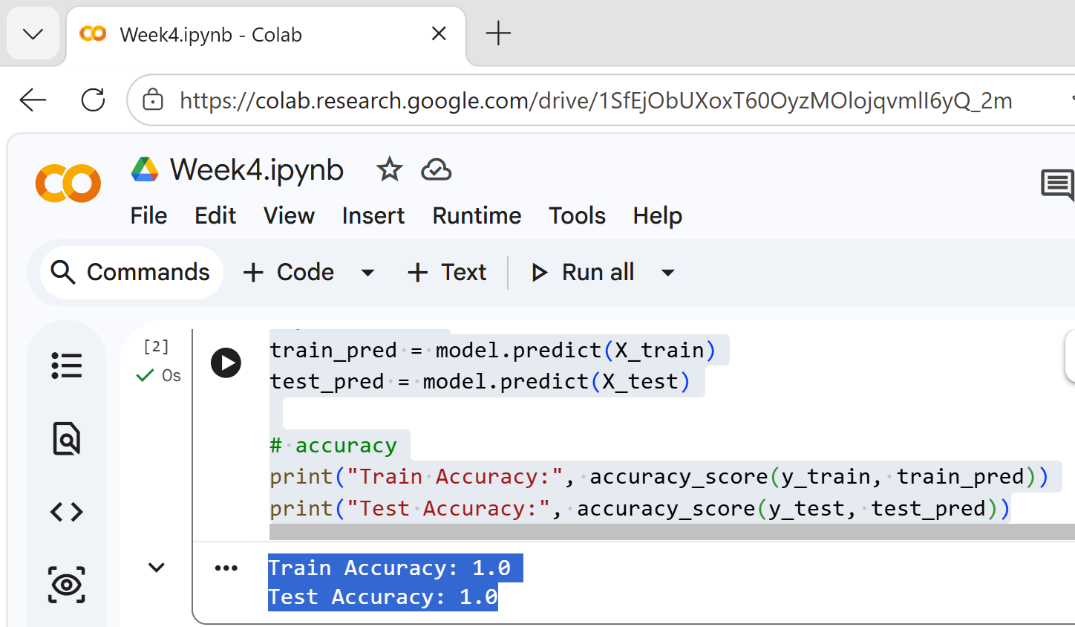
Example 1 – Detect Overfitting (Classification)
Train Accuracy = 1.0
The model got 100% correct on training data
It learned everything perfectly
https://colab.research.google.com/drive/1SfEjObUXoxT60OyzMOlojqvmlI6yQ_2m?usp=sharing

Slide 20
Example 1 – Detect Overfitting (Classification)
Test Accuracy = 1.0
The model also got 100% correct on new (unseen) data
This is very good
https://colab.research.google.com/drive/1SfEjObUXoxT60OyzMOlojqvmlI6yQ_2m?usp=sharing

Slide 21
Example 1 – Detect Overfitting (Classification)
Important note
Getting 1.0 (100%) can mean:
Good case:
The dataset is easy to classify (Iris dataset is simple)
Possible issue:
Sometimes models “memorize” instead of truly learning (called overfitting)
https://colab.research.google.com/drive/1SfEjObUXoxT60OyzMOlojqvmlI6yQ_2m?usp=sharing

Slide 22
Example 1 – Detect Overfitting (Classification)
Summary
You gave the model flower data
It learned patterns
It predicted perfectly
Accuracy = 100% → perfect performance
https://colab.research.google.com/drive/1SfEjObUXoxT60OyzMOlojqvmlI6yQ_2m?usp=sharing

Slide 23
Task for Example 1
Task 1:
Compare train vs test accuracy
Question:
Is the model overfitting?
https://colab.research.google.com/drive/1CI-nYzAYDFoSJIr4BvyxhODfdq7l_h9m?usp=sharing

Slide 24
Task for Example 1
Task 2:
Change test_size (0.2, 0.4)
Question:
Does test accuracy change?
https://colab.research.google.com/drive/1CI-nYzAYDFoSJIr4BvyxhODfdq7l_h9m?usp=sharing

Slide 25
Example 2 – Reduce Overfitting (Limit Tree Depth)
from sklearn.datasets import load_iris
from sklearn.tree import DecisionTreeClassifier
from sklearn.model_selection import train_test_split
from sklearn.metrics import accuracy_score
# load dataset
data = load_iris()
X = data.data
y = data.target
# split data
X_train, X_test, y_train, y_test = train_test_split(
X, y, test_size=0.3, random_state=42
)

Slide 26
Example 2 – Reduce Overfitting (Limit Tree Depth)
# model with limited depth
model = DecisionTreeClassifier(max_depth=3, random_state=42)
model.fit(X_train, y_train)
# predictions
train_pred = model.predict(X_train)
test_pred = model.predict(X_test)
# accuracy
print("Train Accuracy:", accuracy_score(y_train, train_pred))
print("Test Accuracy:", accuracy_score(y_test, test_pred))

Slide 27
Example 2 – Reduce Overfitting (Limit Tree Depth)
Simple Explanation
max_depth controls how complex the tree is
Smaller depth = simpler model
Simpler model = less overfitting

Slide 28
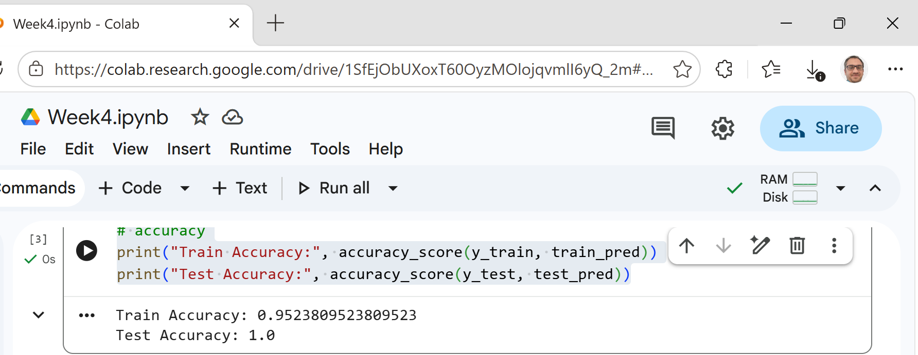
Example 2 – Reduce Overfitting (Limit Tree Depth)
Result Explanation
Train accuracy may drop
Test accuracy may increase
This means model is better balanced

Slide 29
Tasks for Example 2
Task 1:
Try:
max_depth=2 max_depth=5
Question:
Which depth gives best test accuracy?

Slide 30
Tasks for Example 2
Task 2:
Compare with previous model (no limit)
Question:
Which model is better?

Slide 31
Example 3 – Random Forest (Control Overfitting)
from sklearn.datasets import load_iris
from sklearn.ensemble import RandomForestClassifier
from sklearn.model_selection import train_test_split
from sklearn.metrics import accuracy_score
# load dataset
data = load_iris()
X = data.data
y = data.target
# split data
X_train, X_test, y_train, y_test = train_test_split(
X, y, test_size=0.3, random_state=42
)

Slide 32
Example 3 – Random Forest (Control Overfitting)
# random forest model
model = RandomForestClassifier(
n_estimators=100,
max_depth=5,
random_state=42
)
model.fit(X_train, y_train)
# predictions
train_pred = model.predict(X_train)
test_pred = model.predict(X_test)
# accuracy
print("Train Accuracy:", accuracy_score(y_train, train_pred))
print("Test Accuracy:", accuracy_score(y_test, test_pred))

Slide 33
Example 3 – Random Forest (Control Overfitting)
Explanation
Random Forest = many trees combined
Reduces overfitting compared to single tree
n_estimators = number of trees
max_depth = control complexity

Slide 34
Example 3 – Random Forest (Control Overfitting)
Result Explanation
Usually:
Train accuracy high
Test accuracy also high Better performance overall

Slide 35
Tasks for Example 3
Task 1:
Try:
n_estimators=50 n_estimators=200
Question:
Does accuracy improve?

Slide 36
Tasks for Example 3
Task 2:
Remove max_depth
Question:
Does overfitting increase?

Slide 37
Comparison of Examples
Example 1 → normal tree (can overfit)
Example 2 → controlled tree (less overfitting)
Example 3 → many trees (better performance)

Slide 38
Summary – What Students Learned Today
Students now understand:
What overfitting is
How to detect it (train vs test accuracy)
How to reduce it (max_depth, Random Forest)
That:
Bigger model ≠ always better
Simpler models can perform better

Slide 39
Simple Final Message to Students
Good model = balanced model
Not too simple, not too complex
Always check test performance, not just training

Slide 40

Let’s Answer Your Questions
Live during class – Ask directly during sessions.
Canvas Inbox – For structured academic queries.
Email – For formal communications or attachments.
Canvas Discussion – For sharing your questions.
Microsoft Team – Send a reminder if I did not reply after 3 business days

Slide 41

Happy Learning and Bright Futures Ahead!
Stay Connected: linkedin.com/in/farshid-keivanian github.com/FarshidKeivanian
Education is the most powerful weapon you can use to change the world. — Nelson Mandela

Slide 42
Thank You
Have a Great Learning Day!
Feel free to reach out with any questions!

